Slide 1
Digital Portfolio
STUDENT NAME: Gokulraj V
REGISTER NO AND NMID: 20324U09026 08711D29696AC119BE04AD8D952535DE
DEPARTMENT: BCA
COLLEGE:Dr. M. G. R. CHOCKALINGAM ARTS COLLEGE
COLLEGE/ UNIVERSITY

Slide 2
PROJECT TITLE
STUDENT DIGITAL PORTFOLIO USING FRONT END WEB DEVELOPMENTTITLE(HTML, CSS & JAVASCRIPT)

Slide 3


AGENDA
Problem Statement
Project Overview
End Users
Tools and Technologies
Portfolio design and Layout
Features and Functionality
Results and Screenshots
Conclusion
Github Link
3/21/2024 Annual Review

Slide 4
Problem statement
Traditional resumes and static documents often fail to effectively showcase an individual's skills, achievements, and experiences, limiting their ability to stand out in a competitive environment. A digital portfolio addresses this issue by providing an interactive and dynamic platform to showcase one's work and skills.

Slide 5

PROJECT OVERVIEW
A *Digital Portfolio* is an online platform that showcases an individual's:- Skills- Experience- Achievements- ProjectsIt's a dynamic and interactive way to present one's professional identity, enhance career opportunities, and build a personal brand. The project involves designing and developing a digital portfolio website that highlights an individual's strengths and accomplishments.Is that a good starting point?

Slide 6
ARE THE END USERS
Recruiters / Employers – to assess candidate’s skills, projects, and achievements.
Academic Institutions – for evaluating students’ qualifications, projects, and certifications.
Clients – to check credibility and skills before offering freelance or professional work.
Peers / Colleagues – to collaborate, share ideas, or review work.
Self – for personal branding, career growth, and tracking achievements.

Slide 7

TOOLS and Technologies
Website builders (e.g., Wix, WordPress)- Design tools (e.g., Adobe XD, Figma)- Coding languages (e.g., HTML, CSS, JavaScript)- Content management systems (e.g., WordPress, Ghost)- Hosting platforms (e.g., GitHub Pages, Netlify)These tools help create and manage a digital portfolio.

Slide 8
POTFOLIO DESIGN AND LAYOUT
*Portfolio Design and Layout* for a digital portfolio should include:- Clear navigation- Visually appealing layout- Showcase of work and projects- Responsive design- Easy-to-read typography- Consistent brandingThese elements help create a professional and engaging online presence.
8

Slide 9
FEATURES AND FUNCTIONALITY
*Features and functionality* of a digital portfolio may include:- *Project showcases*: Detailed presentations of individual projects- *Multimedia integration*: Images, videos, audio, and other media- *Responsive design*: Adapts to different screen sizes and devices- *Easy navigation*: Intuitive layout and navigation- *Contact information*: Contact form, email, and social media links- *Customization*: Ability to tailor the portfolio to individual needs and brandThese features enhance the user experience and effectively showcase an individual's work and skills.

Slide 10
Results
Improved Presentation – Provides an engaging alternative to resumes; easy navigation through sections.
Accessibility & Responsiveness – Works on both desktop and mobile with responsive design.
Skill Demonstration – Showcases coding projects, certificates, and creativity using HTML, CSS, JS.
Professional Visibility – Enhances personal branding; useful for jobs, internships, and academics.
User Feedback – Positive reviews; well-structured and attractive; scope for adding more interactive features.

Slide 11
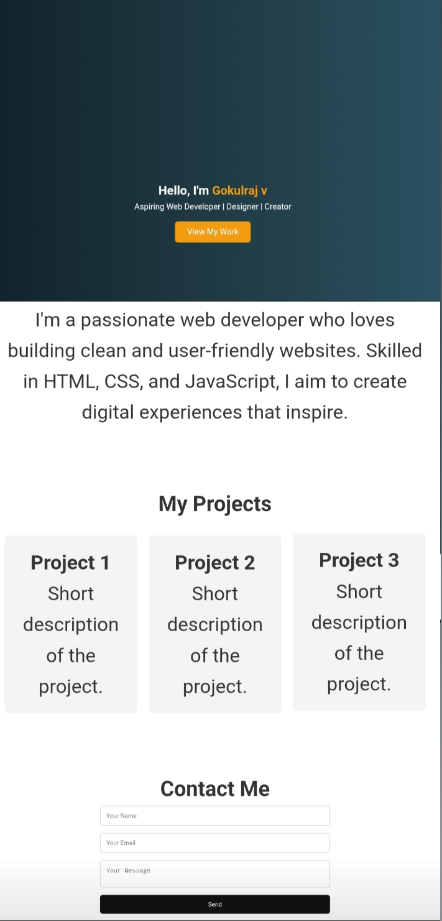

Screenshots/Output
3/21/2024 Annual Review
11

Slide 12
GITHUB PAGE LINK
PROJECT OUTPUT LINK
https://github.com/Gokul57058/digital-portfolio-.git

Slide 13
Conclusion
effectively showcases skills, experience, and achievements, enhancing career opportunities and personal branding in the digital landscape.

